Slide 1
Welcome

Slide 2

EDUCATION SYSTEM OF PAKISTAN:
Equity, Access, Inclusion, and Reform through Community Insight

Slide 3
Education System of Pakistan
Abdul-Wajid Ali
09/14/2026 08:07 PM
Wajid Ali
<number>

Slide 4
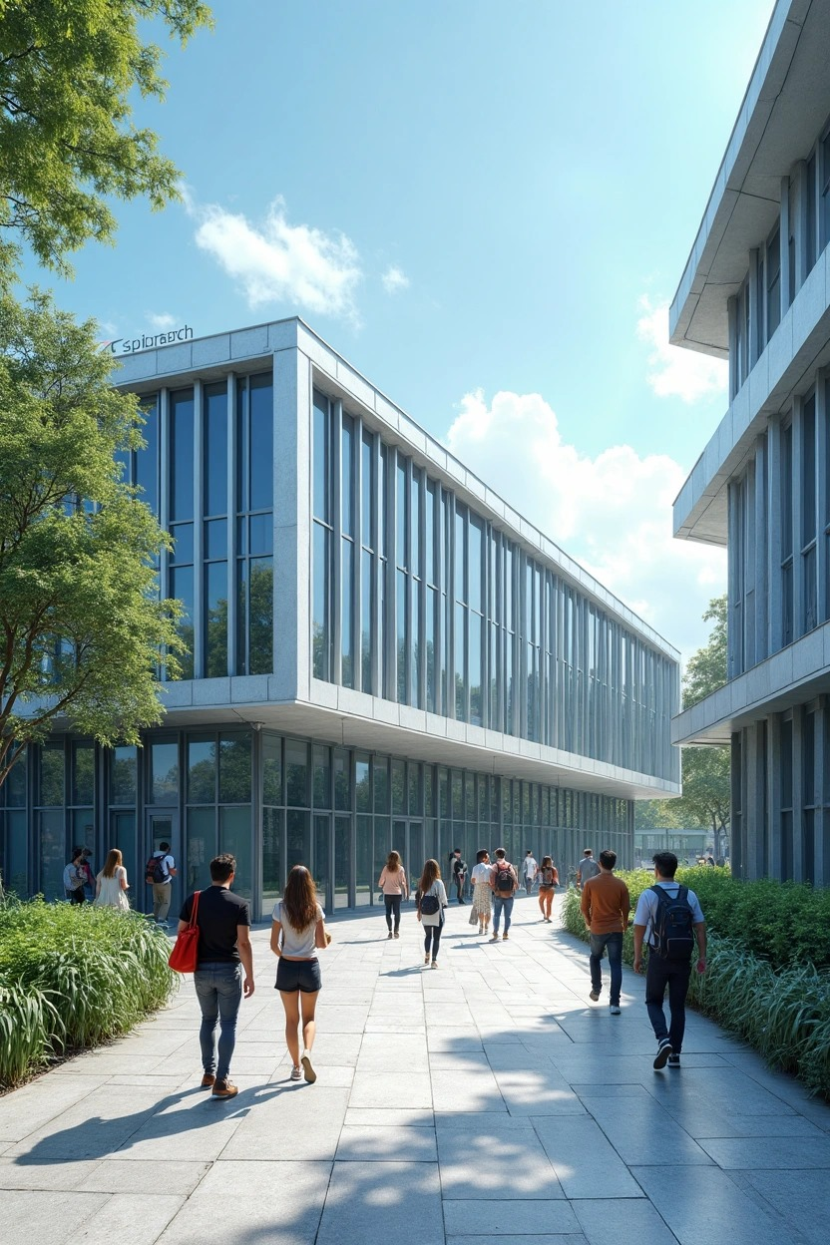
Introduction
Education builds nations, yet in Pakistan:
- 22.8 million children are out of school (UNICEF)
- Low government spending on education (below 2% of GDP)
- Special education remains under-prioritized

Slide 5

Project Objectives
- Analyze general & special education challenges
- Understand institutional performance
- Gather real-life student & teacher feedback
- Compare general and special education
- Recommend practical reforms

Slide 6
Research Methodology
- Quantitative: Google Forms, closed-ended questions
- Qualitative: In-person interviews, open-ended discussions
- Field Visit: Special education institution
- Analysis Tools: Charts, graphs, recorded interviews

Slide 7
Key Findings – General Education
Out-of-School Children: Over 22.8 million children are currently out of school in Pakistan (ASER, 2023), making it the second highest globally.
Drop in Enrollment: Enrollment falls drastically from 67.57% at the primary level to only 14.85% at post-secondary level, indicating a major drop-out crisis.
Geographic Inequality: Students in rural areas face long distances, fewer institutions, and poor transportation access — 40% of surveyed students walk more than 5 km to school or college.
Inadequate Facilities: Around 70% of students reported lacking basic facilities such as functioning labs, clean water, desks, and electricity in their institutions.
Overcrowded Classrooms: Teachers reported managing 50–60 students per class, reducing personal interaction and lesson effectiveness.
Lack of Teaching Resources: Both teachers and students noted absence of multimedia tools, books, and internet connectivity in many institutions.
Digital Misuse: While 86% of students have access to smartphones, most use them for entertainment rather than educational purposes.
Bullying and Harassment: 30% of students reported experiencing bullying or discrimination in school, including gender-based, appearance-based, and ability-based abuse.
Awareness of Scholarships: While 64% of students are aware of scholarships, 81% had never applied, suggesting a lack of guidance, support, and access to application help.
Economic Pressure: Many students from lower-income households work part-time or skip meals to afford education, leading to poor academic performance and mental health challenges.

Slide 8
Out-of-School Children
Pakistan has the second highest number of out-of-school children in the world.
ASER (2023) reports that over 22.8 million children between ages 5–16 are not attending school.
Major causes: poverty, early marriage, child labor, gender discrimination, and poor infrastructure in rural areas.
Example/Stat:
In some districts of Balochistan, enrollment rates are below 20%.

Slide 9
Drop in Enrollment at Higher Levels
Enrollment falls drastically from 67.57% at the primary level to just 14.85% at the post-secondary level.
Many students drop out due to economic hardship, low academic support, or distance from higher education institutions.
Gender disparity increases at higher levels.
Example/Stat:
Girls’ enrollment in rural Sindh beyond grade 8 is less than 10%.

Slide 10
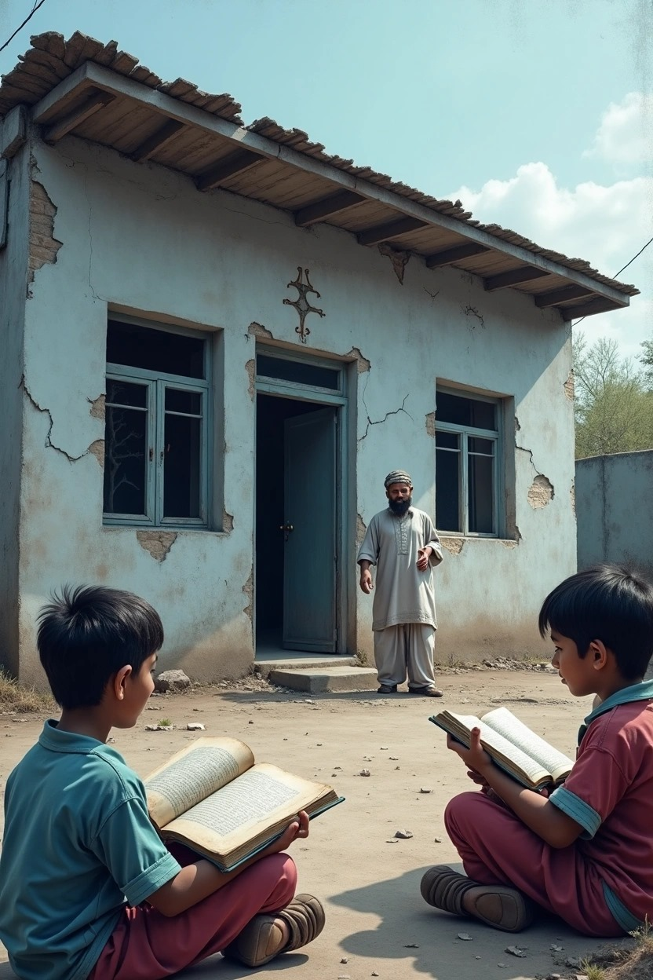
Economic Pressure on Students
Students from poor households often work part-time, skip meals, or miss classes.
Leads to mental stress, poor grades, and eventually dropping out.
Some parents see education as a luxury they cannot afford.
Example/Stat:
In Punjab’s rural districts, over 35% of students work after school hours to support their families.

Slide 11
Geographic Inequality
Students in rural areas often travel over 5 km on foot to reach school or college.
Fewer institutions are located in remote villages.
Transportation facilities are often non-existent or unreliable.
Example/Stat:
In a survey, 40% of students reported walking more than 5 km to school.

Slide 12
Digital Misuse
Though 86% of students have access to smartphones, most use them for social media, games, or videos.
Very few use educational apps or e-books.
Example/Stat:
Only 12% of students reported using their phones for learning purposes.

Slide 13
Inadequate Facilities in Institutions
Schools lack basic facilities like science labs, desks, toilets, drinking water, electricity, and libraries.
These poor conditions negatively impact student learning and health.
Example/Stat:
Around 70% of students surveyed reported inadequate facilities in their school.

Slide 14
Overcrowded Classrooms
Teachers handle 50–60 students per class, especially in government schools.
Overcrowding reduces student engagement, teacher attention, and lesson quality.
Example/Stat:
In urban Karachi schools, the student–teacher ratio is as high as 1:70.

Slide 15
Lack of Teaching Resources
Teachers lack multimedia tools, whiteboards, internet, and updated textbooks.
.
Students cannot afford reference books or e-learning tools, especially in rural areas.
Example/Stat:
Less than 15% of surveyed schools had access to internet or smart boards.

Slide 16
Bullying and Harassment
30% of students report being bullied or harassed in school.
Bullying based on gender, appearance, disability, ethnicity, or academic performance is common.
Many students fear reporting due to shame or lack of support.
Example/Stat:
Girls and students with disabilities reported higher rates of verbal and emotional bullying.

Slide 17
Scholarship Awareness vs Application
While 64% of students knew about scholarships, 81% had never applied.
Causes include lack of guidance, complex application processes, and limited support from institutions.
Example/Stat:
Many students don't know the documents required or deadlines for scholarship applications.

Slide 18
Key Findings – Special Education
- Limited number of special education institutes
- Lack of trained staff
- Poor funding & outdated curriculum
- Students feel isolated from mainstream society

Slide 19
Private vs Public Education
Private vs Public:
Facilities: Better vs Poor
Fees: High vs Low/Free
Teachers: Better-trained vs Less accountability
Special Ed: Rare vs Govt only

Slide 20
Case Study: Blind Professor
- Respected teacher lost vision but continued teaching
- Faced institutional barriers
- Limited tech support
- Role model for inclusive education

Slide 21
Islamic Perspective
- Qur’an: “Are those who know equal to those who do not know?” (39:9)
- Hadith: “Seek knowledge from the cradle to the grave.”
- Islam emphasizes inclusion & education for all

Slide 22
Islamic Guiding Values for Reform
- Equality: Everyone deserves education
- Justice: Serve the underserved
- Compassion: Address emotional & physical needs
- Accountability: Authorities must answer

Slide 23
Recommendations
Increase budget allocation to at least 4% of GDP in line with UNESCO standards.
Renovate and maintain school buildings, focusing on rural areas and government institutions.
Provide basic facilities: clean water, furniture, sanitation, electricity, and secure classrooms.
Install disability-friendly infrastructure (ramps, wide doors, visual aids, and therapy rooms).
Conduct mandatory annual teacher training on:
Child psychology
Inclusive education
Use of digital tools
Classroom management

Slide 24
Recommendations
Offer career incentives and mental health support for teachers to reduce burnout.
Provide special needs teacher training in every province with proper certification.
Revise the national curriculum to focus on:
Critical thinking
Skill-building
Ethics and civic responsibility
Replace rote exams with activity-based assessments, group work, and open-ended questioning.

Slide 25
Recommendations
Offer career incentives and mental health support for teachers to reduce burnout.
Provide special needs teacher training in every province with proper certification.
Revise the national curriculum to focus on:
Critical thinking
Skill-building
Ethics and civic responsibility
Replace rote exams with activity-based assessments, group work, and open-ended questioning.

Slide 26
Recommendations
Arrange regular parent–teacher meetings, especially in rural areas.
Launch awareness campaigns on:
Importance of girls’ education
Access to scholarships
Role of parents in career guidance
Implement anti-bullying policies in all schools.
Establish anonymous reporting channels and appoint trained school counselors.

Slide 27
QR Code for Interview Videos
Insert QR code linking to Google Drive folder with videos:
- Interviews with students
- Teachers (general & special ed)
- School administration

Slide 28
Any Question
If you have any question relevant to my topic, feel free to ask it. I will try to answer your question.

Slide 29
Conclusion
- Education is Pakistan’s backbone—but weak
- Special education remains ignored
- Need data-driven reforms
- Let’s start change today with awareness & action

Slide 30
Thank You
Thank you for your attention.

